Slide 1
FLOOD DETECTION SYSTEM PROJECT
CREATED BY :- PRIYANSHU KUMAR
RAHUL VERMA
RYTHEM SETHI

Slide 2
INTRODUCTION
IoT Early Flood Detection & Avoidance System is an intelligent system which keeps close watch over various natural factors to predict a flood, so we can embrace ourselves for caution, to minimise the damage caused by the flood.
Natural disasters like a flood can be devastating leading to property damage and loss of lives.
To eliminate or lessen the impacts of the flood, the system uses various natural factors to detect flood. The system has a wifi connectivity, thus it’s collected data can be accessed from anywhere quite easily using IoT.
To detect a flood the system observes various natural factors, which includes humidity, temperature, water level and flow level. To collect data of mentioned natural factors the system consist of different sensors which collects data for individual parameters.
Temperature Humidity Sensor is a advanced sensor module with consists of resistive humidity and temperature detection components.

Slide 3
The water level is always under observation by a float sensor, which work by opening and closing circuits water levels rise and fall. It normally rest in the closed position,
meaning the circuit is incomplete and no electricity is passing through the wires yet.
Once the water level drops below a predetermined point, the circuit completes itself and sends electricity through the completed circuit to trigger an alarm.
The flow sensor on the system keeps eye on the flow of water. The water flow sensor consists of a plastic valve body, a water rotor, and a hall-effect sensor. When water flows through the rotor, rotor rolls. Its speed changes with different rate of flow.
All the sensors are connected to Arduino UNO, which processes and saves data. The system has wifi feature, which is useful to access the system and its data over IoT.

Slide 4
OBEJECTIVE
To style a circuit and make a programming code using the microcontroller.
To detect the present level of the flood where the system contains temperature and humidity, water level sensor.
To watch the present level of the flood the collected datas are updated within the website.

Slide 5
REQUIREMENTS
HARWARE SPECIFICATIONS
Arduino Uno
Wifi Module
Temperature Humidity Sensor
Ultrasonic Sensor
Water Flow Sensor
Water Level Sensor
LCD Display
Switch
IC
IC Sockets
Resistors
Capacitors
Transistors
Cables and Connectors
Diodes
PCB and Breadboards
LED
Transformer/Adapter
Push Buttons

Slide 6
REQUIREMENTS
SOFTWARE SPECIFICATIONS
Arduino Compiler
MC Programming Language: C
IOT

Slide 7
FLOW DIAGRAM
Start
Read Water Level
Calculate Height
In the height Greater than Threshold
Display the Readings

Slide 8
PROJECT OVERVIEW
The main objective of the project is to detect rising water level in the river before it take from of flood and cause any destruction and to alert the concerned authorities about the rising level of water.
Microcontroller is interfaced with a water level sensor.
Sensor will send an interrupt to the microcontroller indicating that it has crossed the danger point.
So whenever there is an occurrence of such flood the sensor sends a logic signal to the aurdino that is programmed in such a way that it will show the water level readings to the wireless connected device.

Slide 9
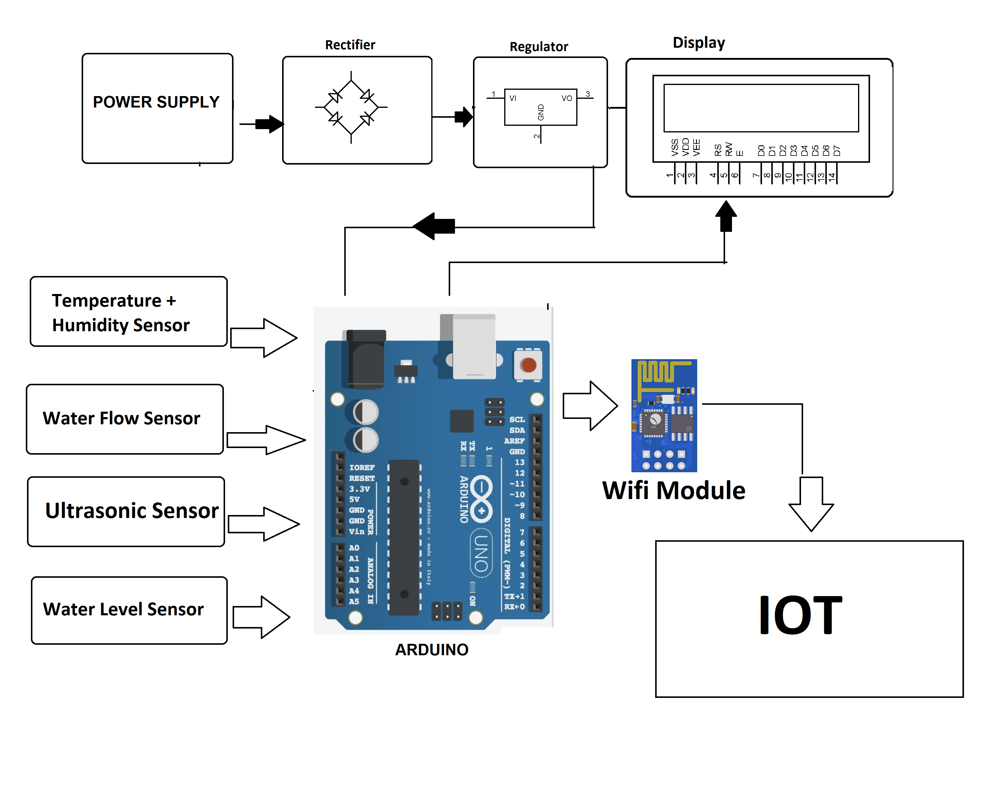
BLOCK DIAGRAM

Slide 10
APPLICATIONS
Monitoring of flood in remote areas.
To track Unexpected Melting of Glaciers.
To avoid wastage of water in large Public tanks.

Slide 11
References
https://nevonprojects.com/iot-early-flood-detection-avoidance/
https://www.electroniclinic.com/flood-monitoring-system-with-sms-alert-using-arduino-and-gsm/
https://nevonprojects.com/iot-early-flood-detection-avoidance/

